Slide 1
Free and low cost activities Basildon

Slide 2
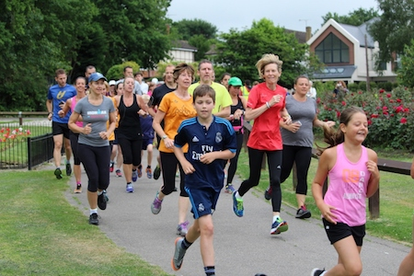
Suggested FREE or Low Cost Activities - Basildon
RUNNING AND WALKING ACTIVITIES: PARK RUN/ PARK WALK Free 5k timed weekly walk or running event Check the website for your local (Basildon, Billericay, Wickford) EVERY SATURDAY (ADULTS) and SUNDAY (FAMILIES) 9 AM Some local events (Billericay Chelmsford and Hockley) run a group for people living with and beyond Cancer at their local park run – last Saturday of every month. www.5kyourway.org` Backside to Trackside https://www.basildon.gov.uk/backsidetotrackside FREE 0 to 5k running programme as and when planned – check their page CURRENTLY AT BASILDON SPORTING VILLAGE MOTIVATED MINDS Mon 1 pm walk from Happy Hub in Basildon FREE Activities and walks from the Happy Hub in Basildon Welcome to Motivated Minds (motivated-minds.co.uk) MIND WALKS Basildon Mind (basmind.org) Twice weekly walking group from Basildon (WEDS) and Vange (FRI) | LOCAL RUNNING CLUBS: (yearly memberships applicable) BILLERICAY STRIDERS Billericay Striders Running Club - Family Friendly Running Club % Billericay Striders Running Club - Family Friendly Running Club % PHOENIX STRIDERS Welcome | phoenixstriders PITSEA RUNNING CLUB HOME | Pitsea Running Club The Run Fit Club https://www.facebook.com/runfit2019 Various walk, walk/run, running, strength conditioning and other activities £5 a year membership with all sessions free

Slide 3
Suggested FREE or Low Cost Activities - Basildon
FAMILY ACTIVITIES: FREE #MeetMovePlay https://park-play.com/ FREE ACTIVTY SESSION FOR FAMILIES IN YOUR LOCAL PARK SAT AM FREE community activities in Basildon and Laindon Check the website for what’s on where ESSEX ACTIVATE- FREE SCHOOL HOLIDAY CLUBS AND SUPPORT w.activeessex.org/children-young-people/essex-activate/ www.activeessex.org/essex-activate-get-supportcet.co.uk FREE FOOTBALL | ATF: FREE ACTIVITIES FOR CHILDREN https://www.atfcommunity.com/whatson FC Redwing Football https://www.facebook.com/FCRedwing FREE ACADEMY FOIR BOYS AND GIRLS (reception and Yr1) FREE GIRLS FOOTBALL – WILDCATS RECEPTION to YR 6 PL KICKS FOOTBALL – SOUTHEND Contact d.hall@southendunited-cet.co.uk JUNIOR PARKRUN: Sundays 9 am at selected parkrun locations junior events | parkrun UK

Slide 4
POPULAR WITH OLDER ADULTS Over 50s Activity Clubs (Yearly membership plus small class fee per session- https://www.basildon.gov.uk/activitycentres Your local centres are:- GEORGE HURD CENTRE The George Hurd Activity Centre – Basildon LAINDON ACTIVITY CENTRE The Laindon Activity Centre - Basildon PITSEA ACTIVITY CENTRE The Pitsea Activity Centre – Basildon SHORT MAT BOWLS Plenty of local clubs available including Hannakins Short Mat Bowls Club, Billericay (hugofox.com) U3A (UNIVERSITY OF THE THIRD AGE) Basildon & Billericay u3a: Groups (u3asites.org.uk) Activities for retired people led by members so activities are lower Cost. Small yearly membership fee applies. | POPULAR CLASSES (FEES APPLY) STROLLERCISE 50s dance fitness HOME | Strollercise - Stroll Your Way To Fitness MOVE IT OR LOSE IT Low impact exercise Find a Class - Move it or Lose it ZUMBA GOLD Lower impact version of this popular dance workout www.fitandfab.co.uk MOVEMENT TO MUSIC WITH EMMA (5) Movement to Music with Emma | Facebook Low impact aerobics Contact me for other ideas of paid for clubs and classes
Suggested FREE or Low Cost Activities - Basildon

Slide 5
Suggested FREE or Low Cost Activities - Basildon
INCLUSIVE ACTIVITIES www.activeessex.org/find-your-active/- FREE ONLINE CLASSES workout-channel/ WALKING FOOTBALL Walking Football Near Me - The WFA Club Directory Contact club for prices WALKING NETBALL Via Basildon Sporting village app or website Basildon Sporting Village | Gym, Swim, Climbing & More | Everyone Active INCLUSIVE FOOTBALL AND SPORTS Inclusive Sport - Providing sports and activities for all abilities SNAP - Special Needs And Parents. Registered charity (No.1077787) (snapcharity.org) For families with children with additional needs aged 0-25 MIND BASILDON (FREE) Allotment in Vange open Tuesdays Basildon Mind (basmind.org) TRUSTLINKS: (FREE) Gardening and Mental Health support New site opening in Vange Jan 2023 Growing Together Basildon: Therapeutic Gardening - Trust Links | SPORT FOR CONFIDENCE Sport For Confidence Various inclusive activities £3.50 no need to book.

Slide 6
Suggested FREE or Low Cost Activities - Basildon
CURRENT FUNDED / FREE REFERRAL AND NHS SUPPORTED PROGRAMMES Let’s Move Essex Programme (versusarthritis.org) FREE sessions for people with arthritis/ MSK Conditions in Pitsea and Laindon Dance on Prescription/Arts for Health - Central Basildon Primary Care Network (centralbasildonpcn.nhs.uk) https://www.yoga4all.co/yoga4health 10 week FREE yoga programme via referral Suitable for those with with stress, mild anxiety or depression. At risk of Type 2 diabetes or a cardiovascular event or suffering from social isolation. Cancer Rehab Programmes at Club Kingswood Health Club referrals made via email to referme@impulseleisure.co.uk | Bike mechanic training courses for those with MH issues incl free refurbished bike, helmet and lock upon completion at Thorndon Country Park. Referral via SP to info@trailnet.org.uk Rose Villa Community Garden Project Pitsea anyone can come along email sallyj@trustlinks.org Laindon Buggy Walks – open to all

Slide 7
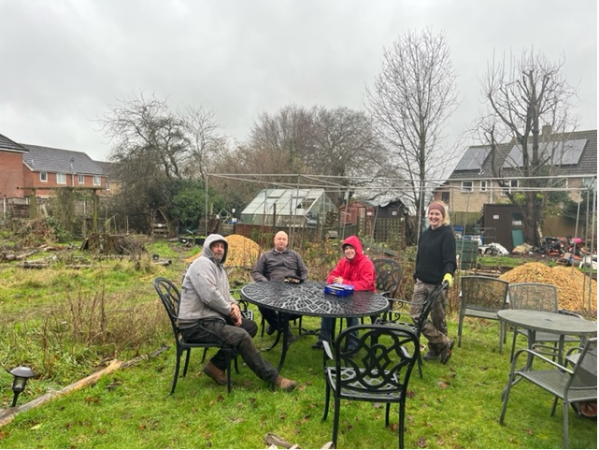
Suggested FREE or Low Cost Activities - Basildon
Other ideas: Billericay Men’s Shed https://www.facebook.com/BillericayMensshed 07544 752686 Andy’s Man Club Basildon – peer to peer support #itsgoodtotalk http://www.andysmanclub.co.uk/ FREE TO ATTEND MON 7pm Lincewood Primary School Langdon Hills Craig Tyler Trust https://www.thecraigtylertrust.co.uk Mental Health support groups and suicide prevention Yoga- donation based on what you can afford YOGA CLASSES | Southend-onSea | Yoga4all Online and in person | #ThisGirlCanEssex ambassadors are offering fun and free activities all across the county to get you moving during our #WomenLikeUs festival week, sponsored by WI Essex, in celebration of International Women's Day! Give involved and sign up today: https://www.activeessex.org/.../women-like-us-festivals/ Community Gardens and Gardening Friends Of Lake Meadows Friends of Lake Meadows | Facebook Friends of Great Berry Community Group Friends of Great Berry Community Group | Facebook Billericay Community Garden Billericay Community Garden | Billericay | Facebook Friends of Wickford Memorial Park Friends of Wickford Memorial Park - Home (3) Environmental Activities Volunteering - Trust Links | Facebook Trust links community Projects LITTER PICKING Billericay Litter Pickers | Facebook Wickford Wombles | Facebook

Slide 8
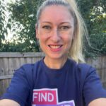
Suggested FREE or Low Cost Activities - Basildon
Kat Gordon Community Connector Basildon HOW I CAN HELP? Promote activities through our facebook page and within the community Signpost individuals to an activity Come along to and promote your activities Provide pop ups for organisations and the public | FOR ANY HELP FROM ME FINDING AN ACTIVITY… PLEASE JOIN https://www.facebook.com/FindYourActiveBasildon Message through the facebook page or email: kat.Gordon@ceessex.org.uk 07514 726338 Search and add activities for free here https://www.activeessex.org/activity-finder/

